Slide 1

Sprint 2, Team 6
Cameron Chambers, Cedric Rutijana, Ricardo Gonzalez Mendez, Zuhdi Abujayyab, Yubin Hu, Zixi Rao

Slide 2
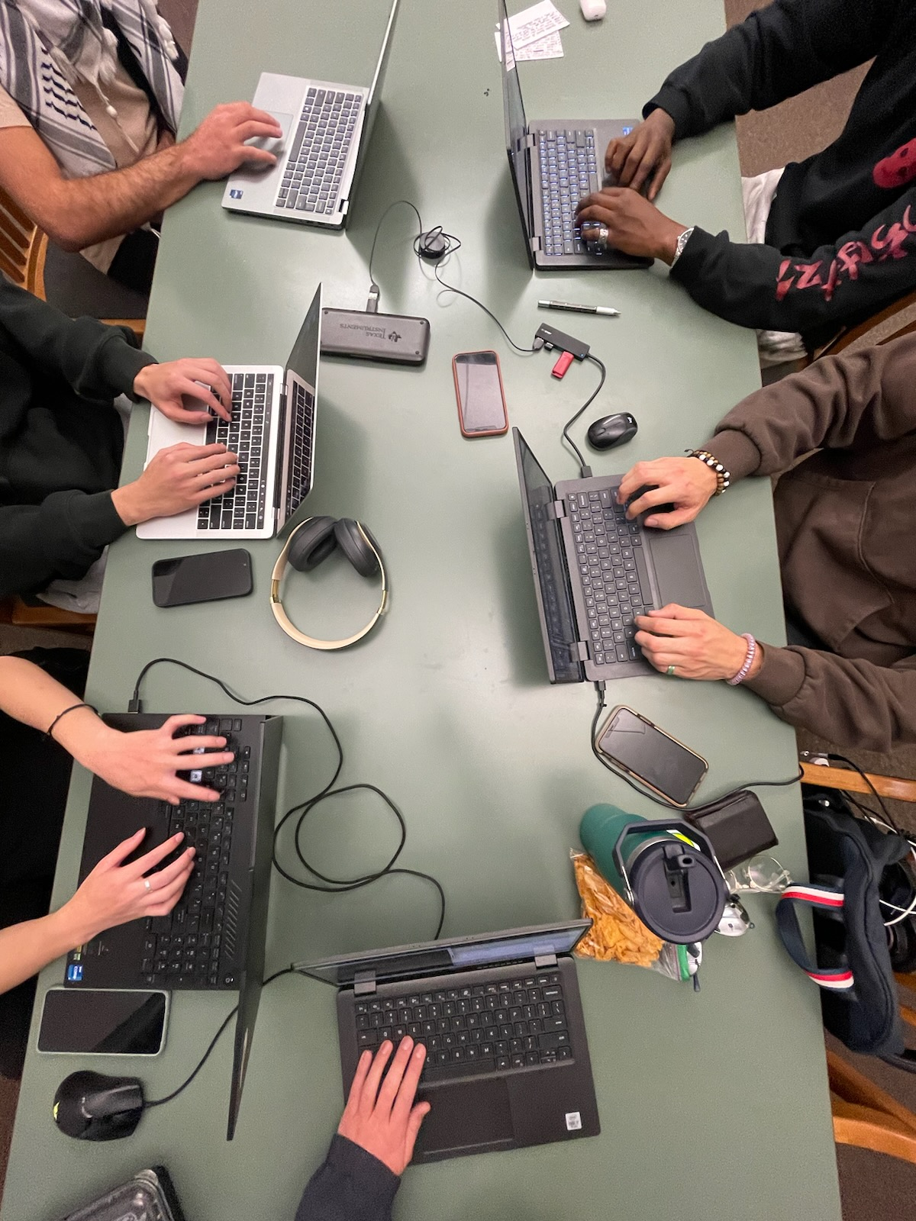
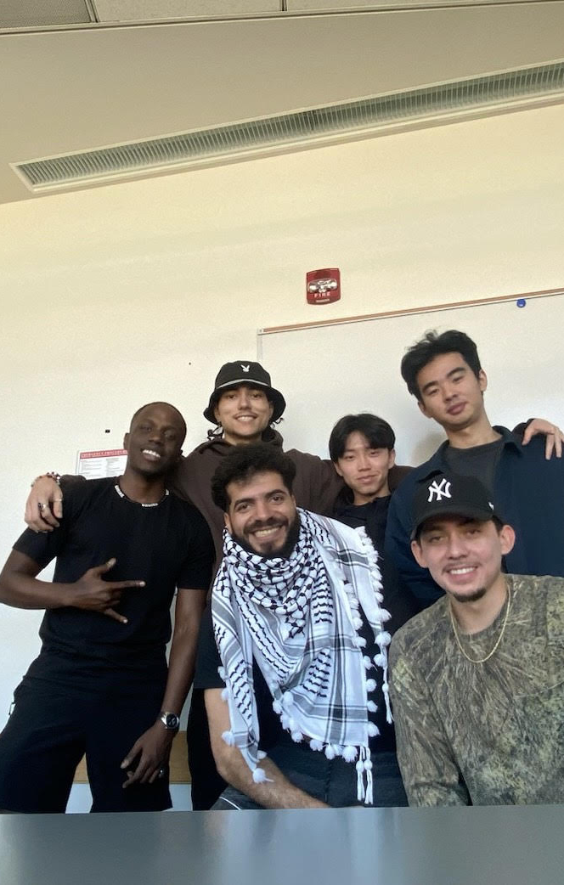
Our team is focused on designing a website aimed towards helping individuals experiencing distress, whether that distress be mental, financial, or any other type. We understand that life can cause unexpected hardship, & we want to help those with these unexpected experiences in any way that we possibly can.
Our Project,
What We’re Building

Slide 3
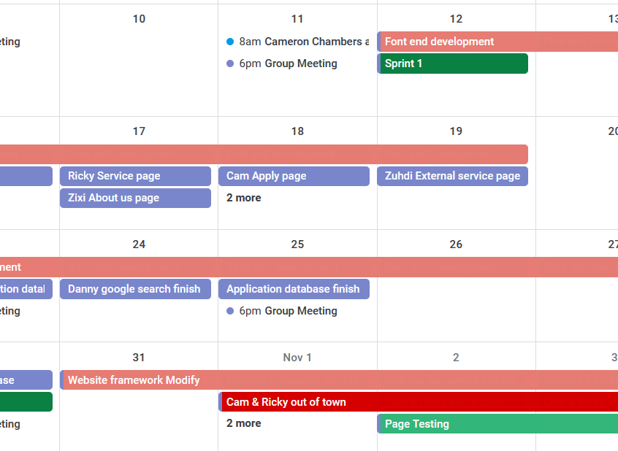
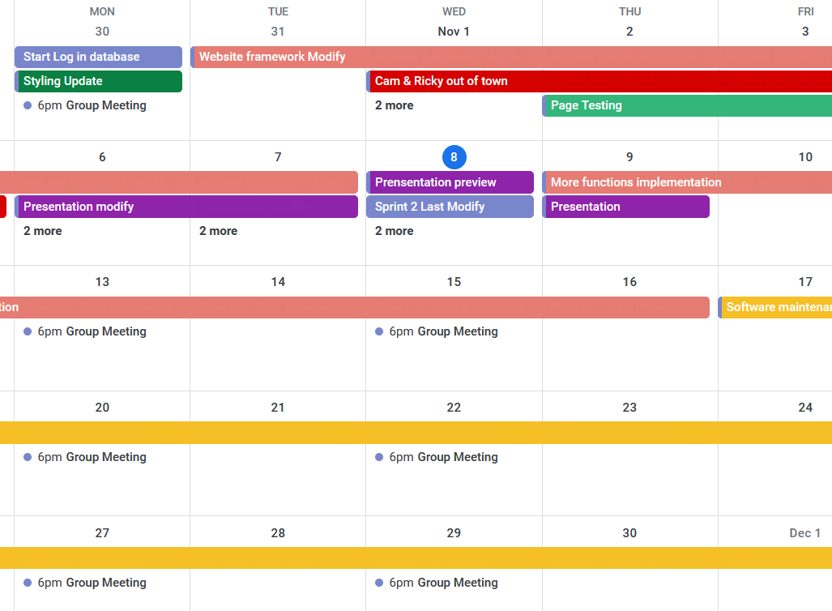
Project Calendar
https://calendar.google.com/calendar/embed?src=yubinhu%40suumail.net&ctz=America%2FDenver

Slide 4
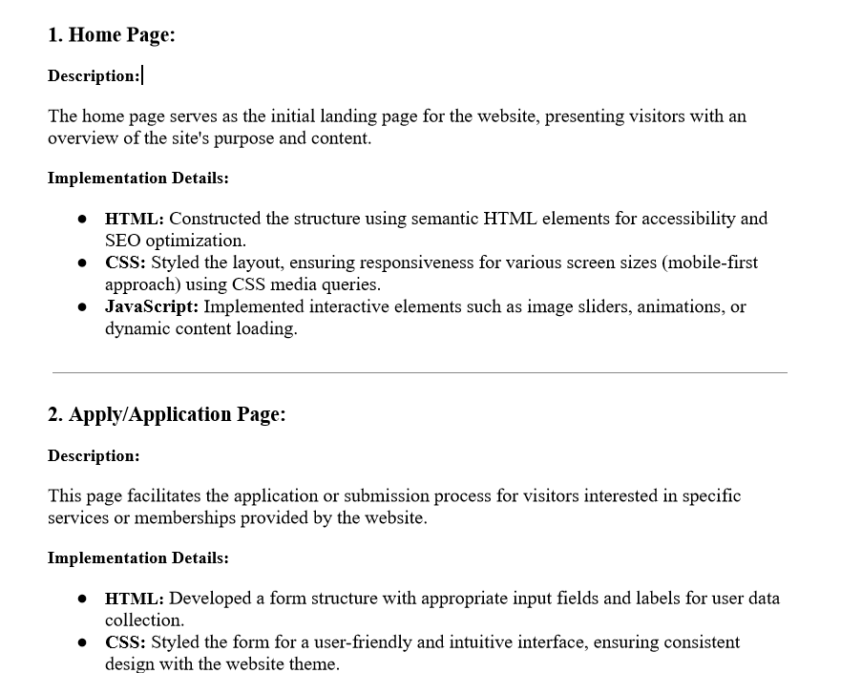
Documentation
Throughout our project, we have been thoroughly documenting our process and steps. We have created a documentation form to account for everything we’ve accomplished.

Slide 5

Progress Made, Plans for Sprint 3
Following Sprint 1, we have achieved the following:
Substantial progress on website development
Back-end development for login functionality
Set up search engine to work with Google
For Sprint 3, we plan on achieving the following:
Set up two-factor authentication for login purposes
Work on search database for internal searches
Set up account page for application form purposes

